Slide 1
Data 608, Final Project: USA Migration/Internal Mobility
By Mikhail Groysman, 7/22/2019

Slide 2
Motivation: Internal Migration – Where? Why?...
USA is a country of immigrants
Many of us, being immigrants themselves, can relate
Less talked about – internal/interstate migration
Many different reasons for internal migration
Many of us might or has migrated in from one to another state
Questions – Where? Why? How many?

Slide 3
Current Knowledge – History/Reasons
USA long history of internal migration
Westward migration of 19th century
Migration from California – 21st century
Reasons – work related
Reasons – housing factors
Other reasons

Slide 4
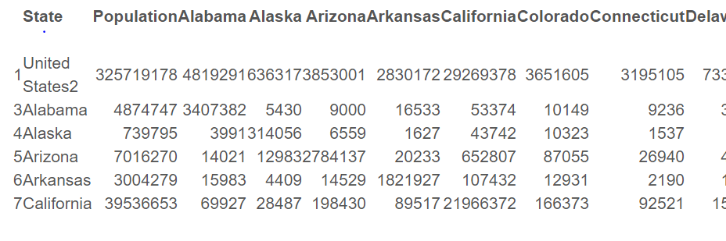
Data Source – Census
USA Census, American Community Survey, 2017
URL:https://www.census.gov/topics/population/migration/data/tables/acs.html

Slide 5
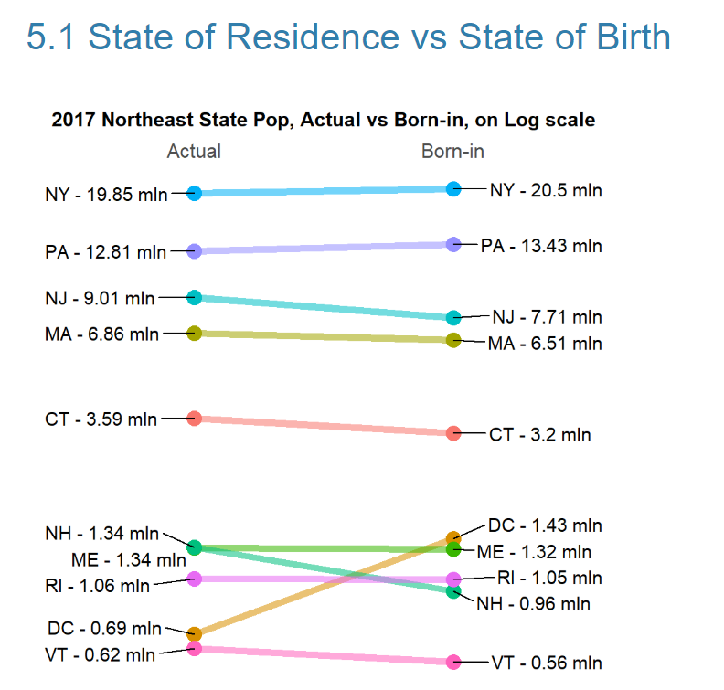
State of Current Residence vs State of Birth

Slide 6
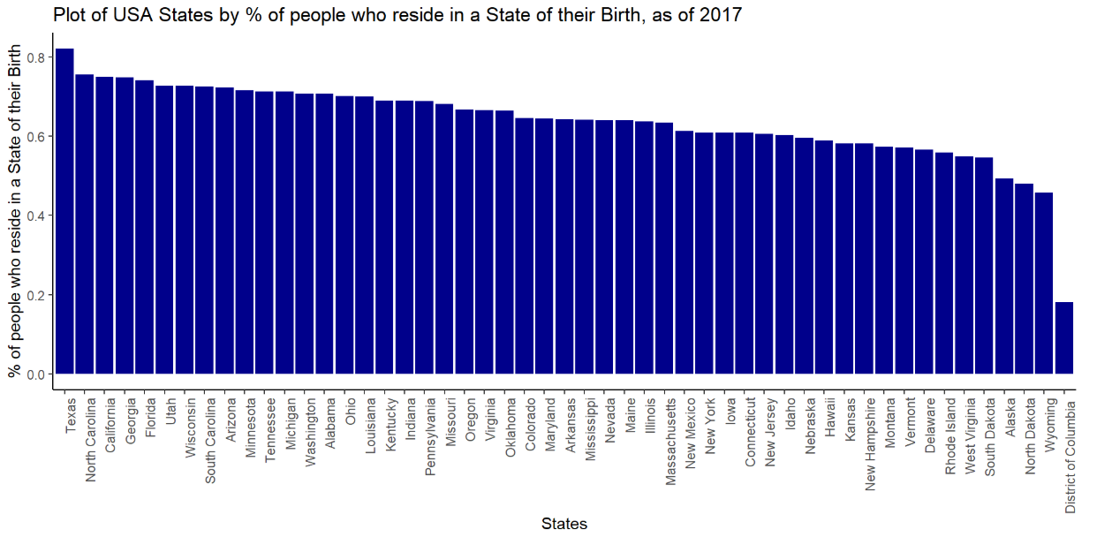
% of People Born and Still Residing in the State of Birth

Slide 7
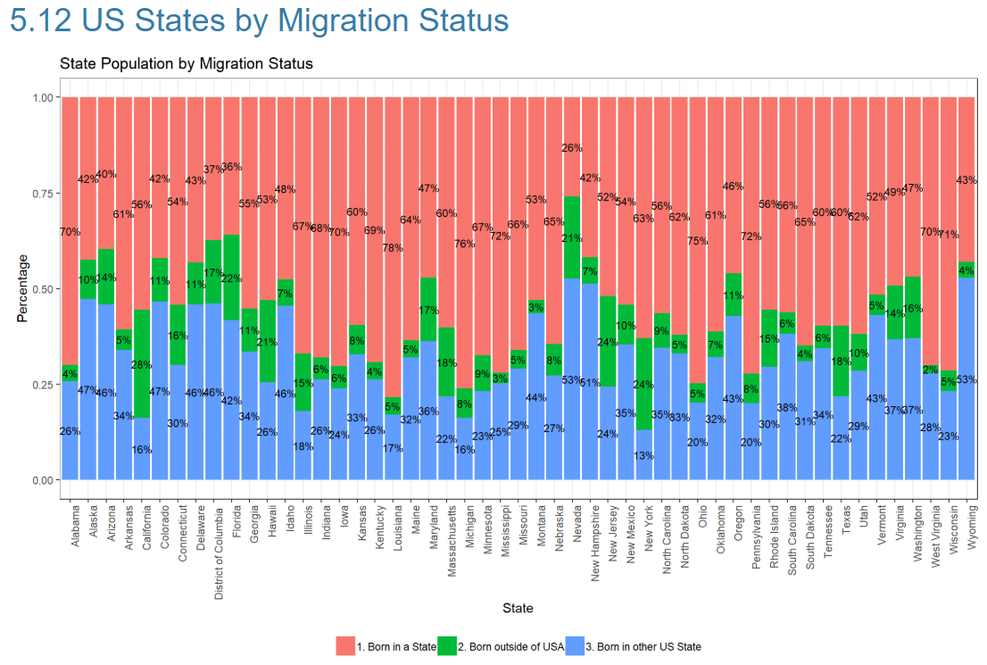
US State Population by Migration Status

Slide 8
Conclusions – High Diversity in Internal Migration Behavior
Big gainers from migration - Nevada, Florida, and Texas; Americans prefer to migrate to states which are to South from them
Biggest losers due to migration are DC, North Dakota, and West Virginia, adjusting for population
New York is a very unique state - a big gainer from foreign immigration and a big loser from domestic migration
People born in Texas have the lowest mobility in USA, overall South has low mobility
In Nevada, over 70% of residents were born outside of the state
Wyoming, Nevada, and New Hampshire attracts a lot of domestic migrants, adjusting for population

